Slide 1

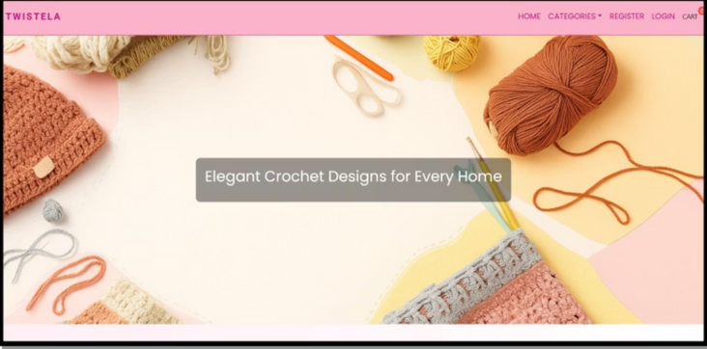
Twistela: Elegant Crochet for every home
Members:
1.Astha Dadhaniya (92400584069)
2.Kreena Jotangiya (92400584121)
3.Krisha Shah. (92400584182)

Slide 2
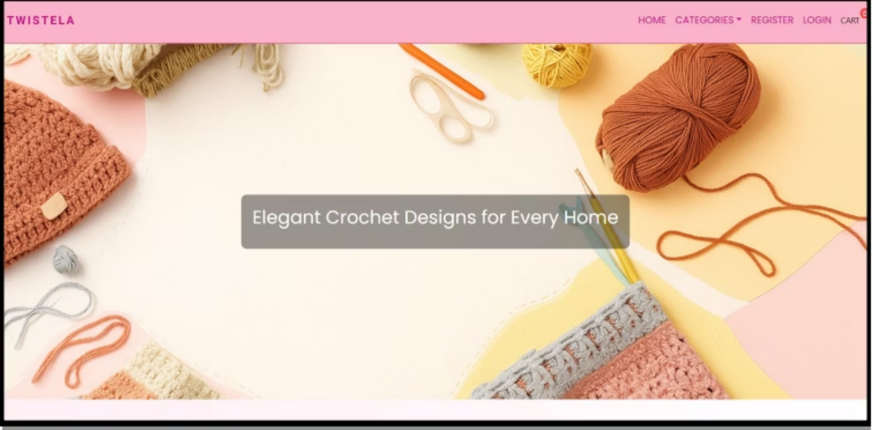
Chapter 2
Twistela: Seamless E-commerce Experience
Twistela is a full-featured eCommerce platform enabling users to browse, filter, and purchase products, while offering administrators control over inventory and order management. It supports browsing without login, and enforces login for actions like adding to cart or placing orders. Admins also must authenticate to manage data.

Slide 3
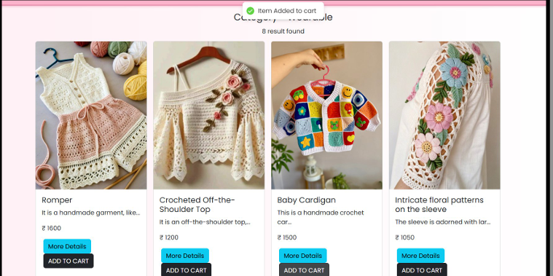
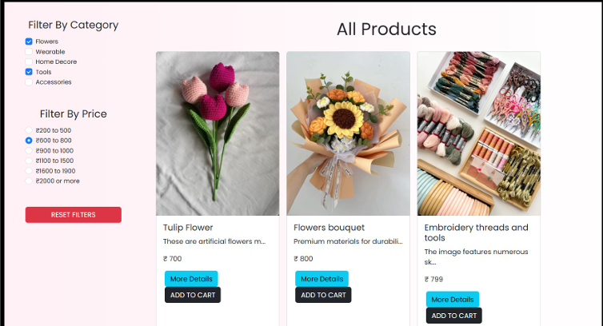
Chapter 2
Preamble:
E-Commerce has revolutionized modern shopping by making it faster and easier to access products. Twistela aims to offer a seamless online shopping experience using scalable full-stack technology. It bridges the gap between user satisfaction and admin efficiency, blending product browsing, secure checkout, and real-time inventory management.

Slide 4
Chapter 2.1
Module Descriptions
Client/User Module
Admin Module
Browse products without login.
Access site interface without login.
Login required for cart, orders, history, and address updates.
Authentication required for admin functions.
Manage product categories, listings, and user orders.
Manage profile and track orders post-login.
Secure dashboard for system monitoring.

Slide 5
Chapter 3
Review of Literature:
User Experience
Admin Portals
Unauthenticated browsing is crucial for initial engagement.
Strong CRUD operations and access control are essential.
Authentication
Engagement
Cart and checkout actions must always require user login.
Product filtering and real-time updates enhance user interaction.
Our analysis of similar e-commerce platforms like Mindori and Enchanted Threads highlighted these critical aspects for a successful system.

Slide 6
Chapter 4
Technical Specifications:
Hardware Requirements
Software Requirements
Operating System: Windows
Processor: Intel i3 or higher
Hard Disk: Minimum 250 GB
Database: MongoDB + Mongoose
RAM: 8GB or more
Frontend: React.js, Bootstrap/CSS
Backend: Node.js, Express.js
Authentication: JWT
Code Editor: VS Code

Slide 7
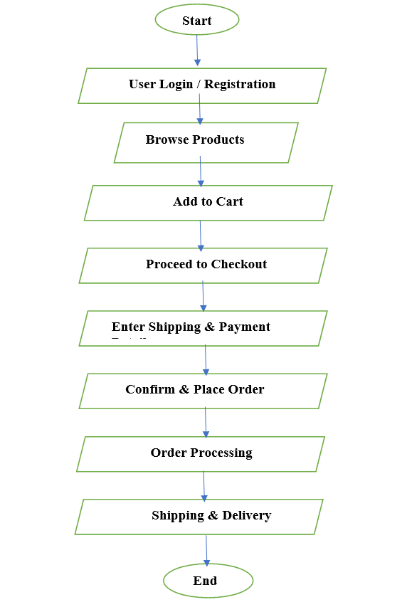
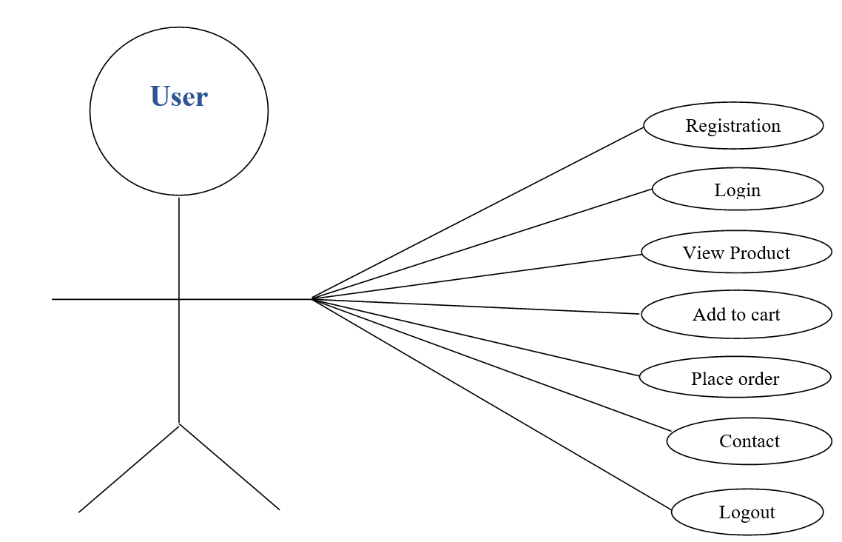
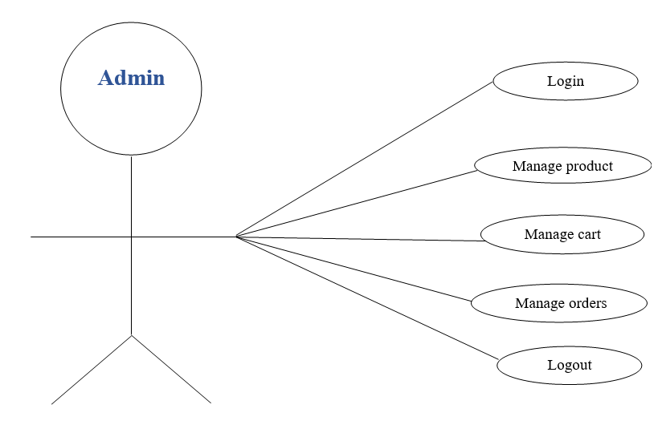
Chapter 5
System Design: Flow Chart, UseCase Diagram

Slide 8
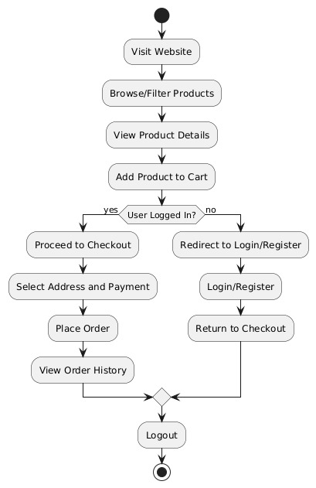
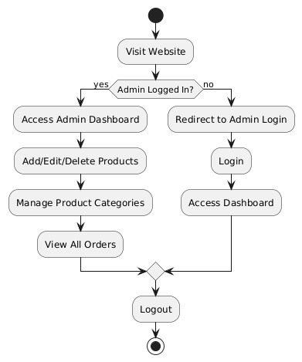
Chapter 5
System Design: Activity Diagram (User, Admin)

Slide 9
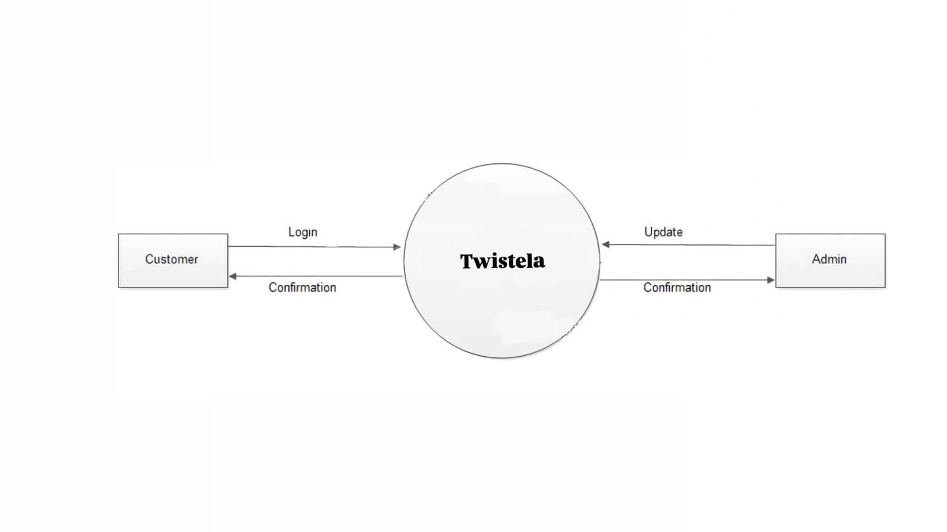
Chapter 5
System Design: DFD (0 level)

Slide 10
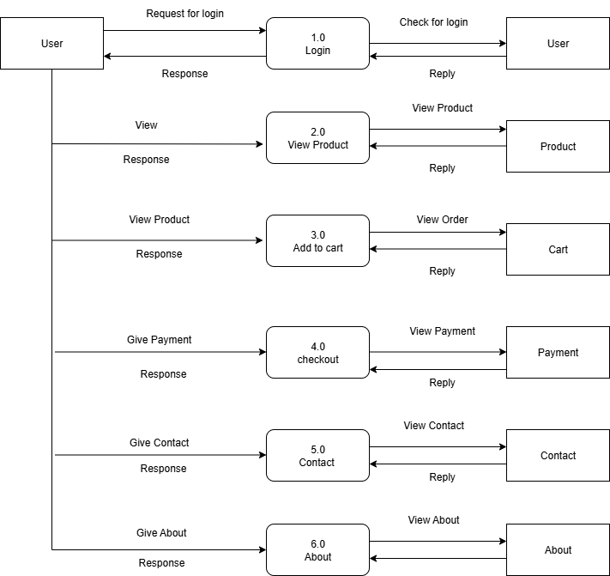
Chapter 5
System Design: DFD (1 level)

Slide 11
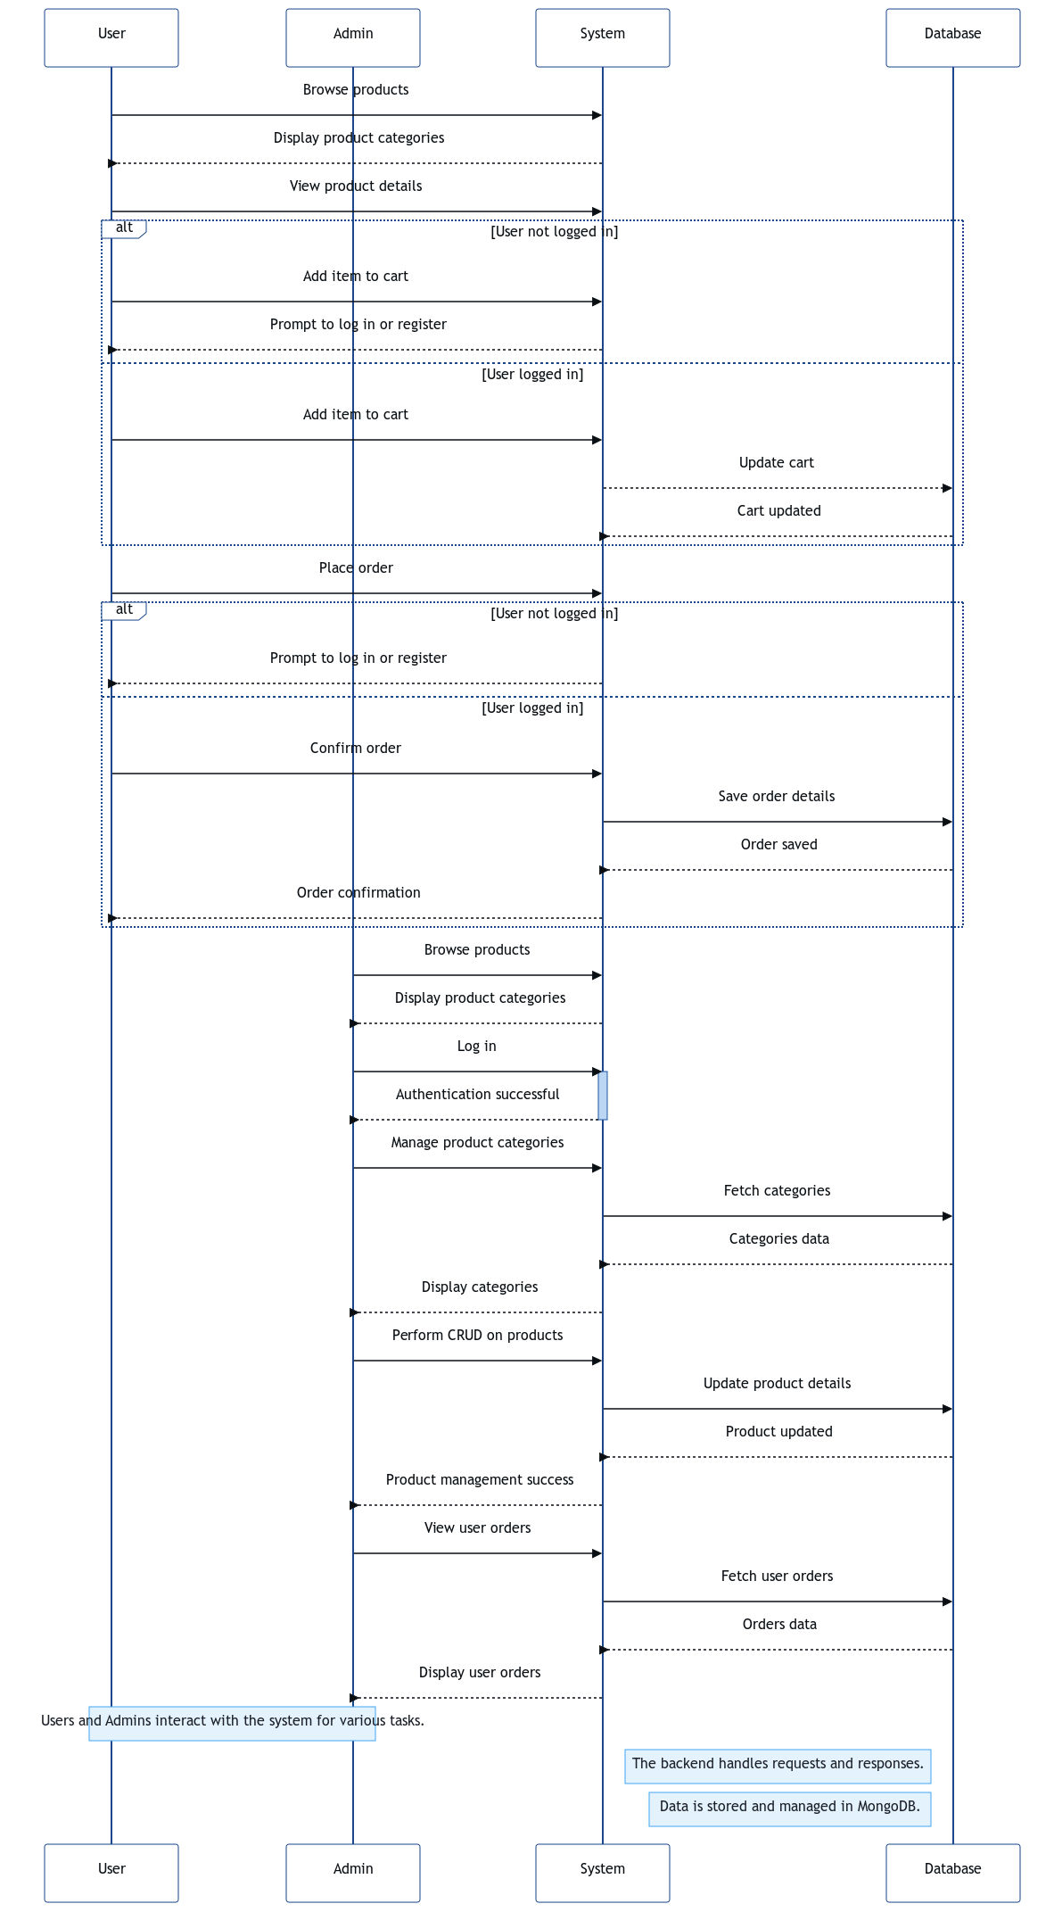
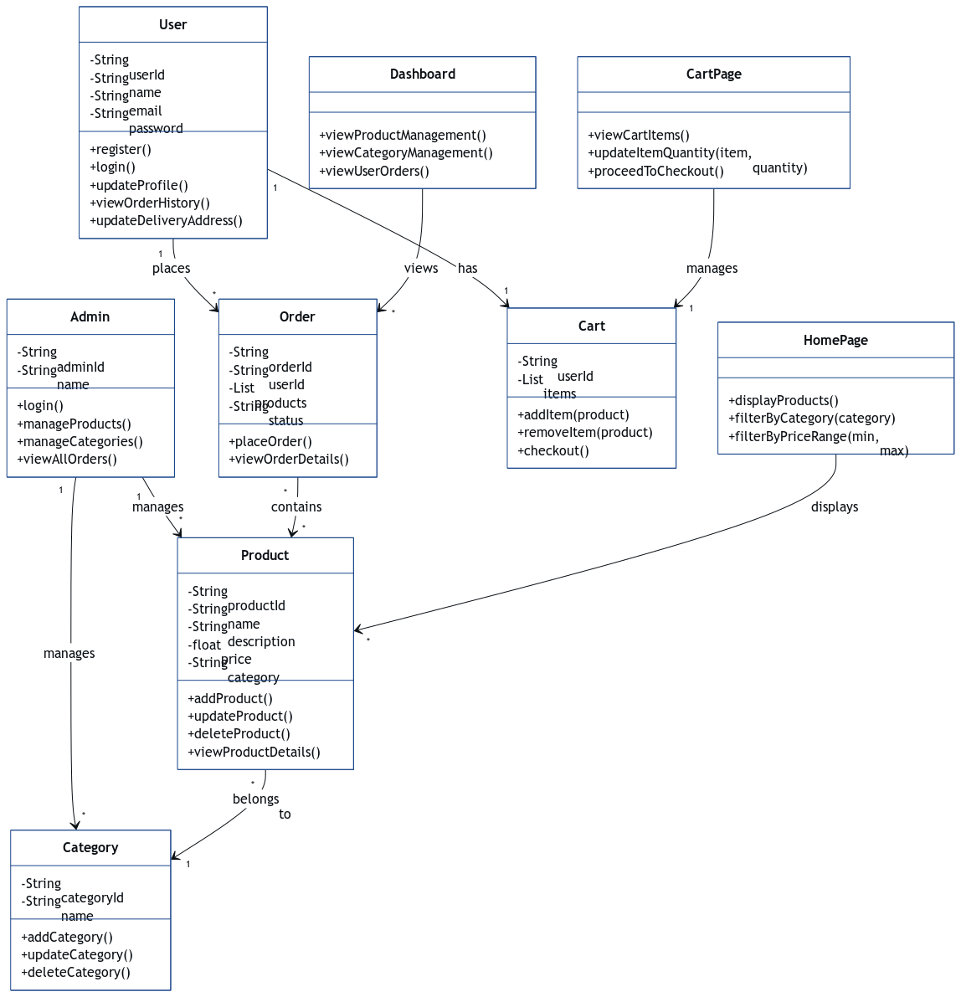
Chapter 5
System Design: Sequence and Class Diagram

Slide 12
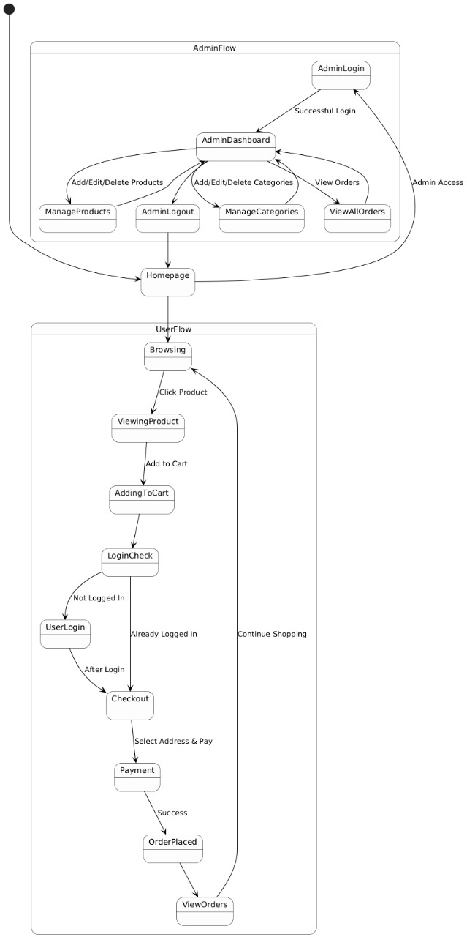
Chapter 5
System Design: State Diagram

Slide 13
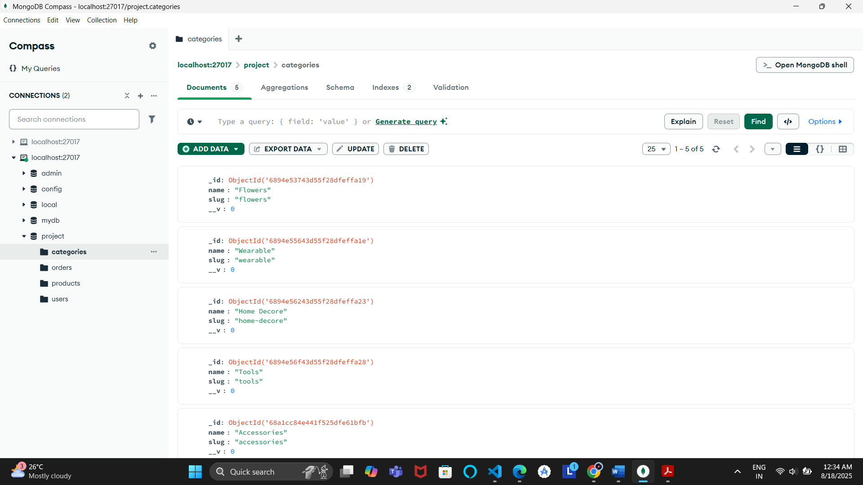
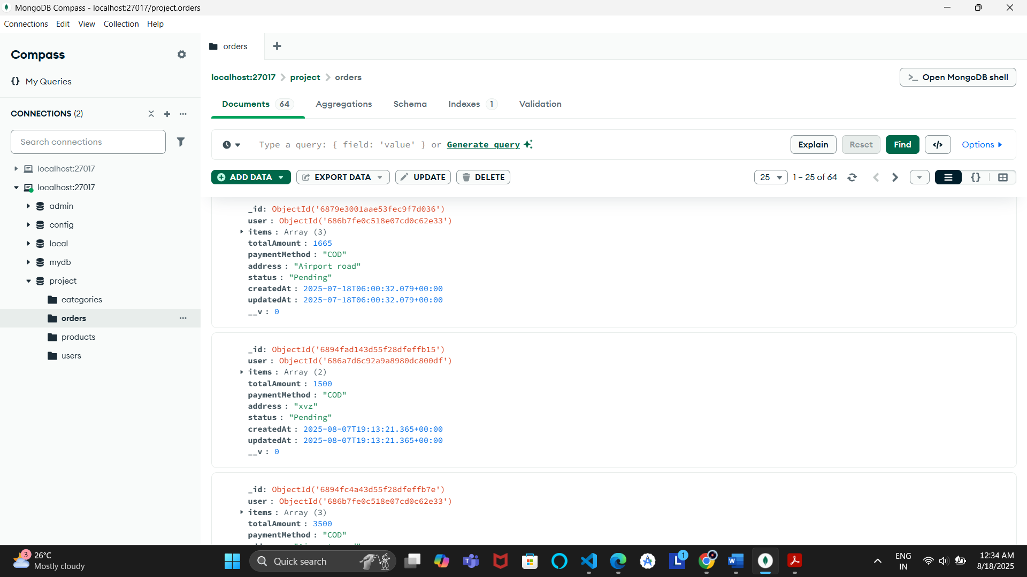
Chapter 5
System Design: File Structure/ Database Design
Backend Folder Structure:
/controllers
/models
/routes
/config
/middleware
Frontend Folder Structure:
/components
/pages
/context

Slide 14
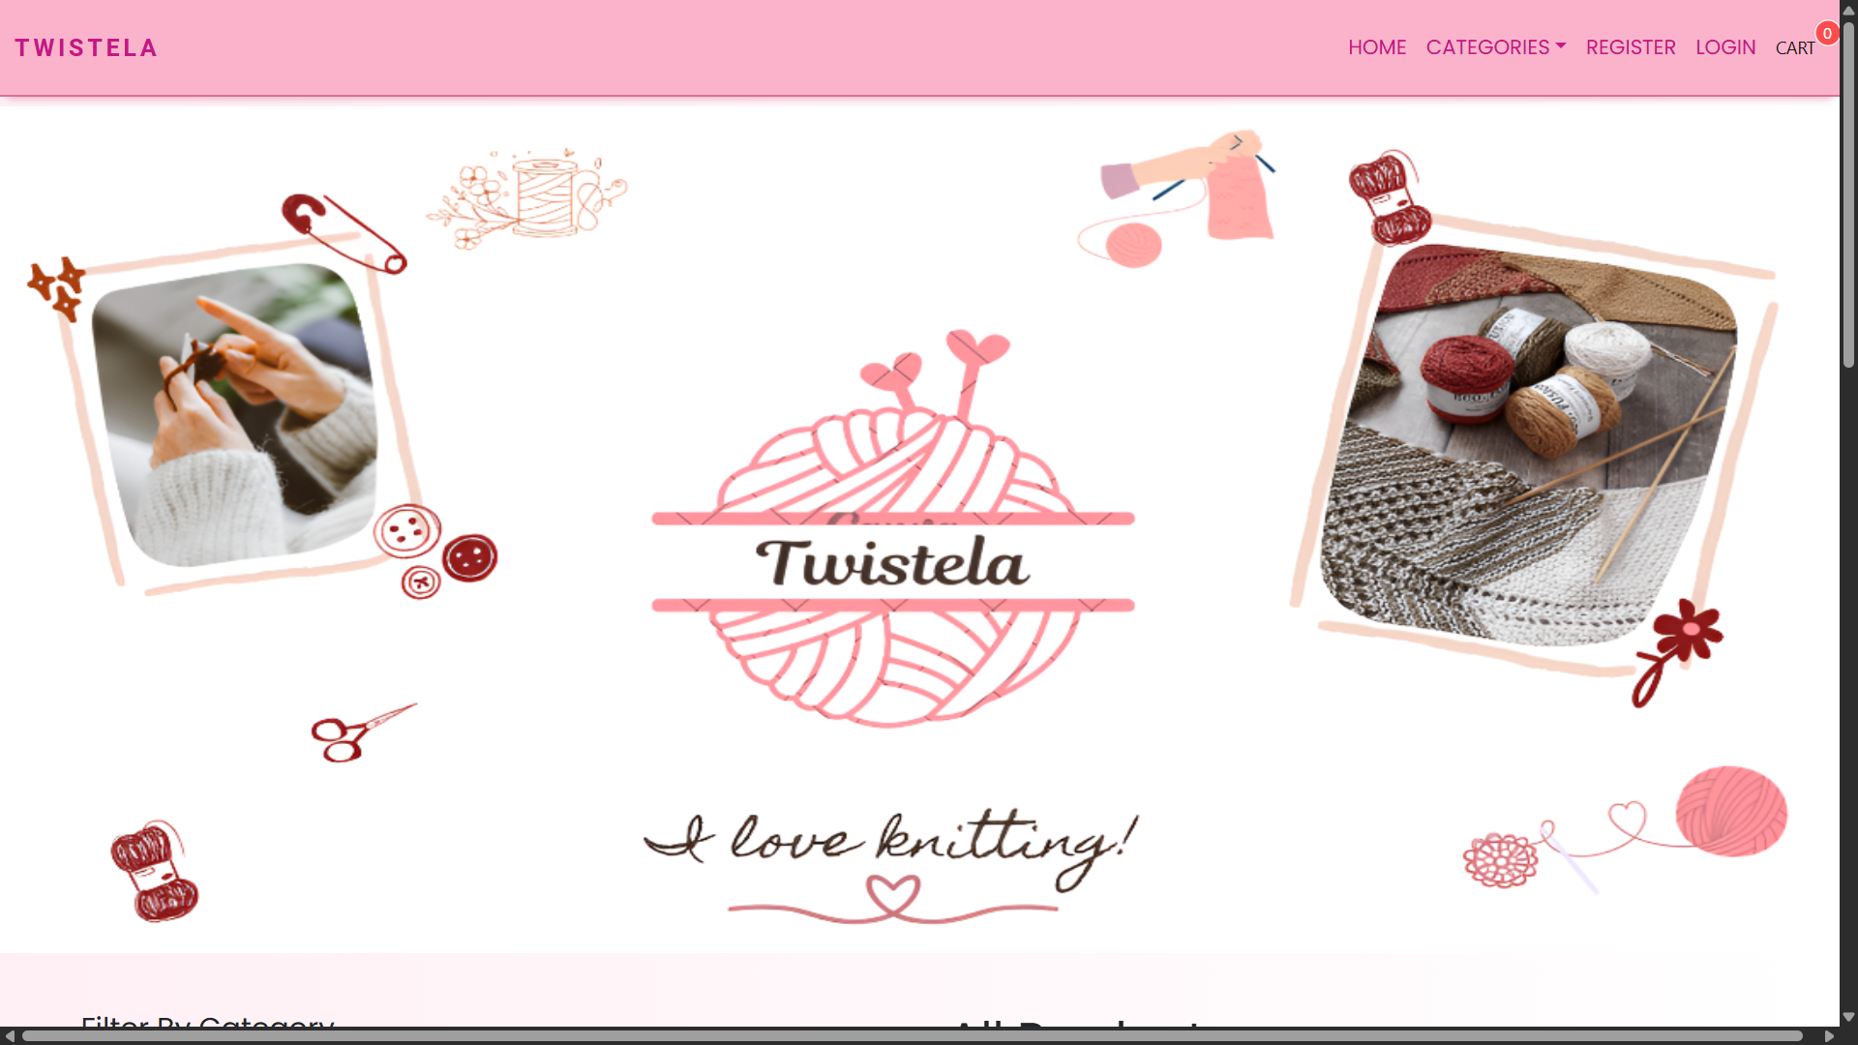
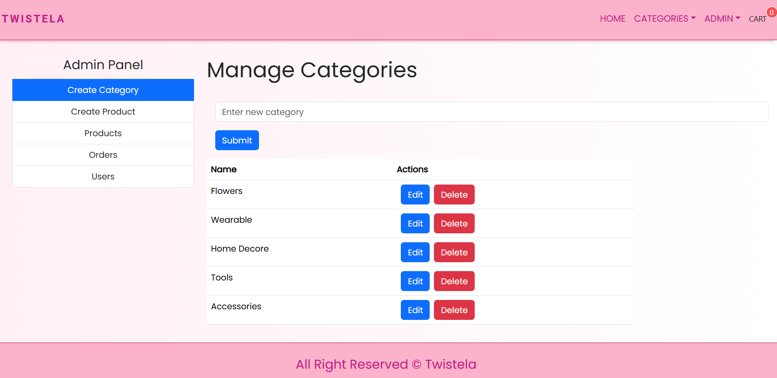
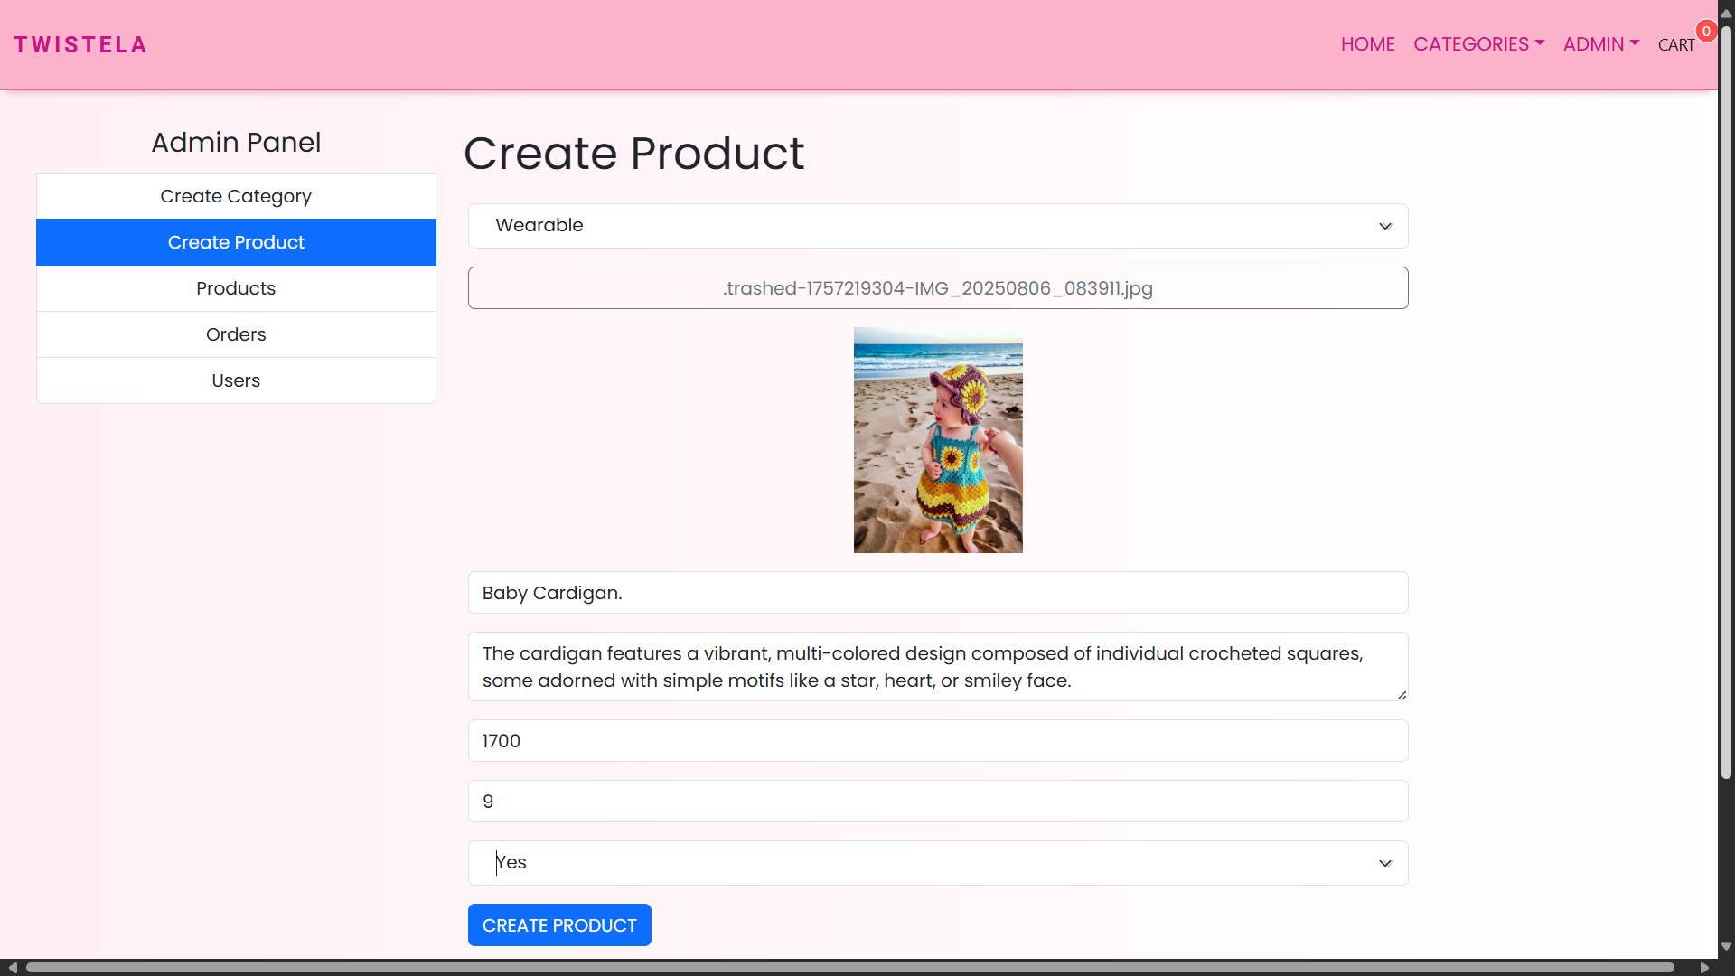
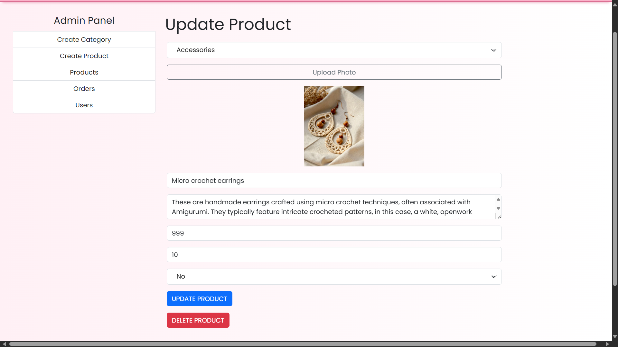
Screen Design

Slide 15
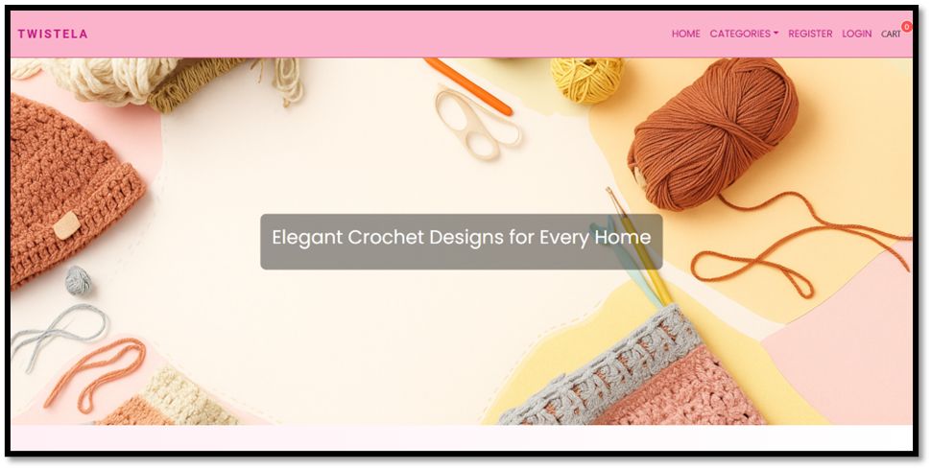
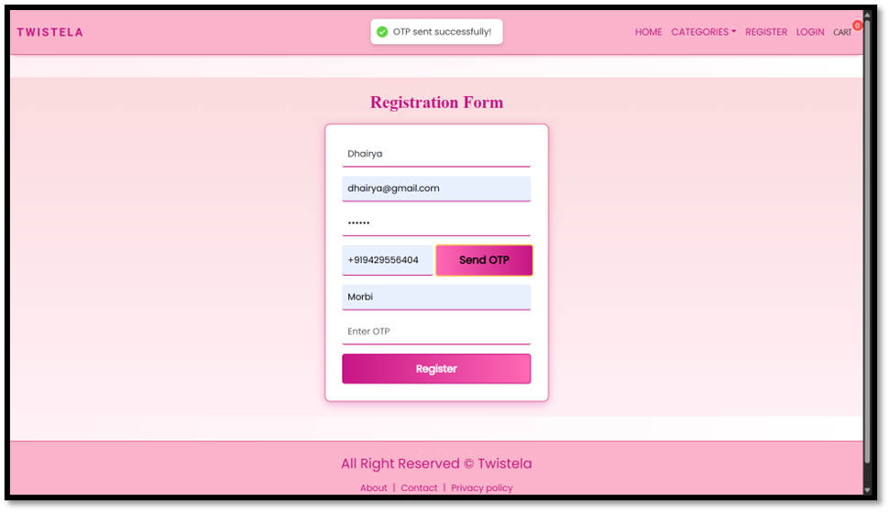
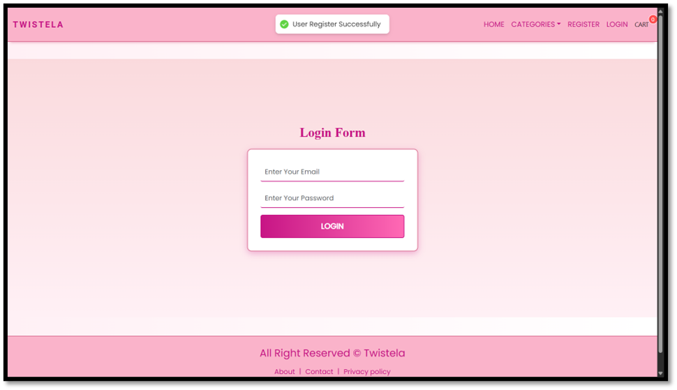
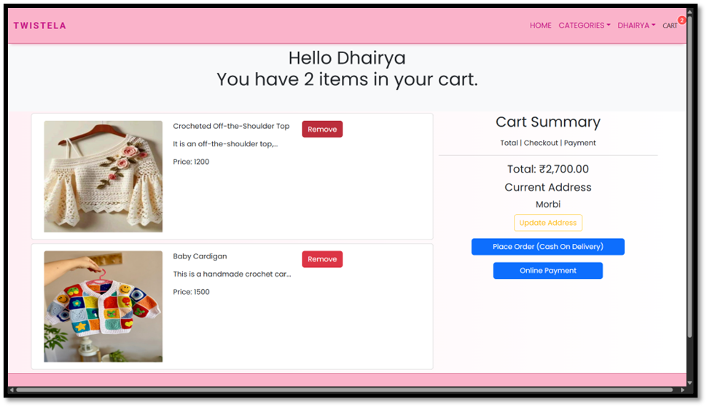
Screen Design

Slide 16
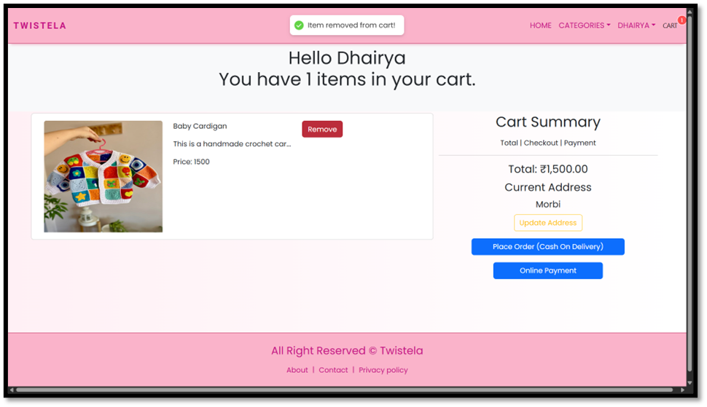
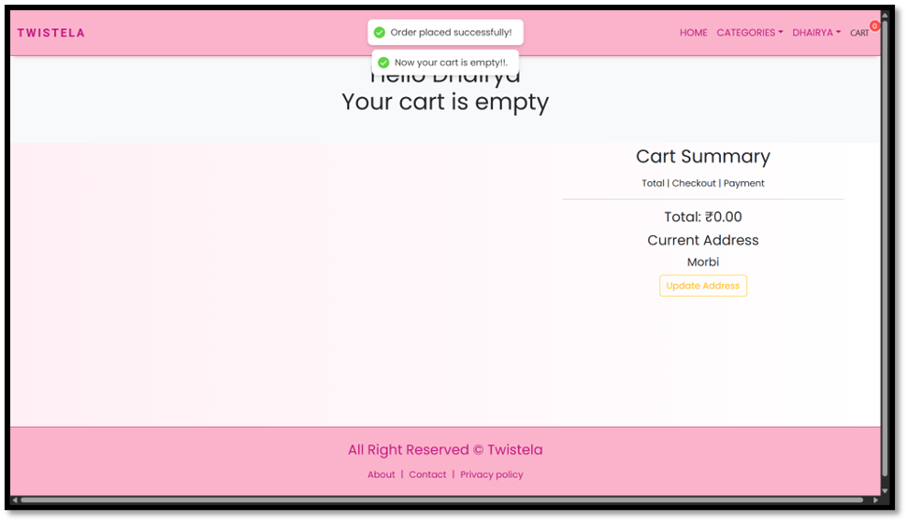
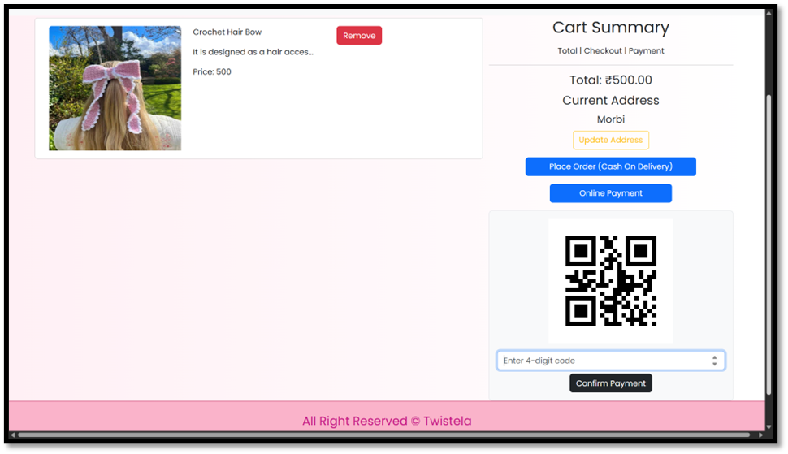
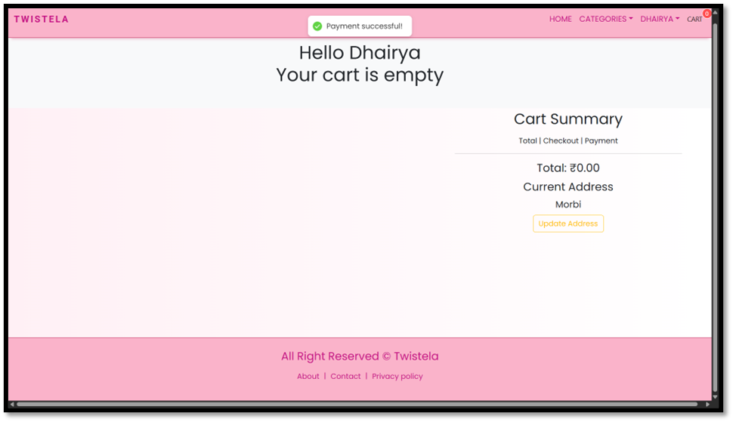
Screen Design

Slide 17
Chapter 6
System Testing:
Test Case – User Registration
Test Case - OTP Send
Test Case Number | 101
Test Case Name | User Registration
Description | Verify that user can register with a unique email & password
Expected Outcome | New user account created in database
Actual Outcome | As per Expected Outcome
Pass / Fail | Pass
Test Case Number | 104
Test Case Name | OTP Generation
Description | Verify that OTP is sent to registered mobile number
Expected Outcome | OTP received on phone
Actual Outcome | As per Expected Outcome
Pass / Fail | Pass

Slide 18
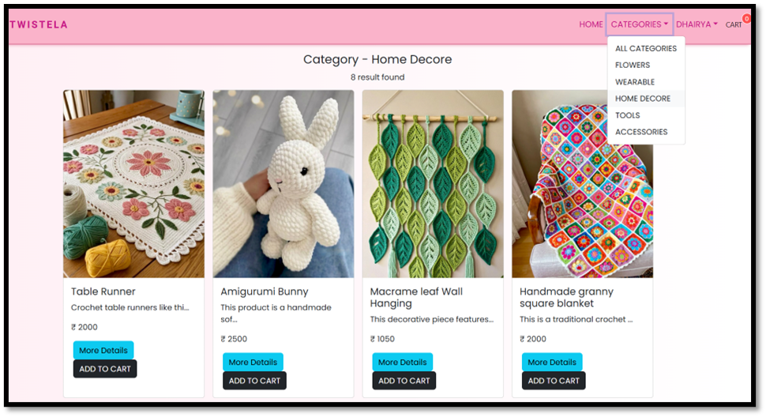
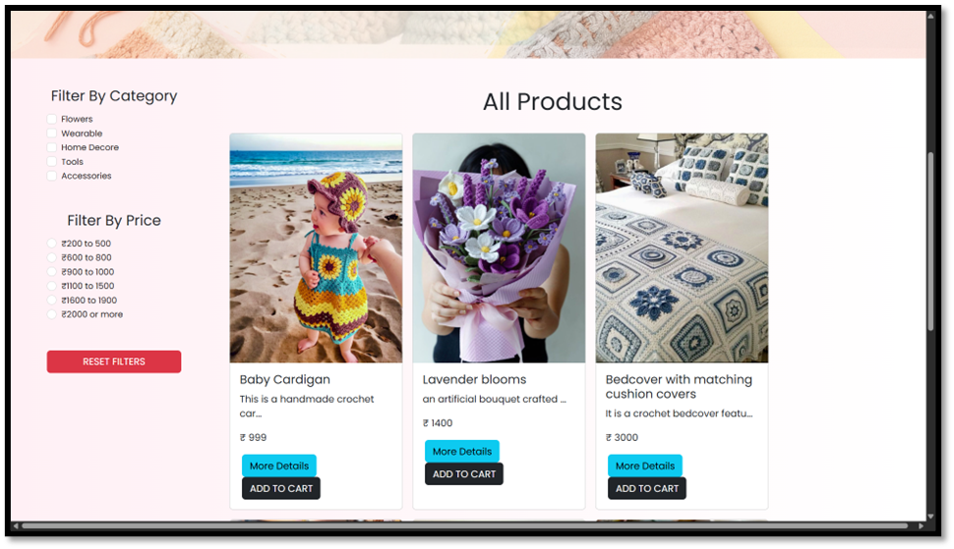
Chapter 7
Conclusion:
The Twistela application successfully demonstrates the implementation of a modern e-commerce platform using the MERN stack. By integrating MongoDB, Express.js, React.js, and Node.js, the project ensures a scalable, efficient, and user-friendly environment for managing crochet product sales. Core features such as user registration, OTP-based authentication, product management, cart, and checkout flow have been implemented to simulate real-world online shopping. These modules collectively provide both customers and administrators with a seamless experience.
In conclusion, this project demonstrates not only technical skills in full-stack development but also the ability to design a complete business solution. Twistela can be further extended into a fully functional online crochet marketplace, bridging the gap between handmade product creators and customers through a robust digital platform.

Slide 19
Bibliography
Online References
Offline References
React (Core & Router) — Official Docs
https://reactrouter.com/api/other-api/adapter
Node.js & Express — Official Docs
https://expressjs.com/
MongoDB & Mongoose — Official Docs https://www.w3schools.com/mongodb/
JSON Web Tokens — jwt.io (spec/usage)
https://www.jwt.io/
Twilio Verify (OTP) — Official Docs
https://www.jwt.io/
Axios — GitH1ub README / docs
www.github.com
Learning React (2nd Ed.)
Full-Stack React Projects
MongoDB The Definitive Guide

Slide 20

THANK
YOU

